Slide 1
MS SQL Server Analysis Services As Online Analytical Processing Tool

Slide 2
Agenda
Significance of OLAP in Reporting
Online Transaction Processing (OLTP)
Data Warehouse (DW)
Online Analytical Processing (OLAP)
OLAP Tools
SQL Server Analysis Services (SSAS) features
Applicability of OLAP to Explorer Utility

Slide 3
Significance of OLAP in Reporting Tools
Analysts usually monitor business activities through Reports
In earlier days mostly reports are part of the transaction systems itself. Hence reports were using data from the transaction database directly
Analysts facing performance and data inconsistency issues while generating reports from transaction systems. While report generation normal users also affected with performance
Subsequently, to overcome the performance and inconsistency issues data is maintained in a separate database called Data Warehouse
Data warehouse addresses the data consistency issues but may not give the expected performance for reporting
Online Analytical Processing (OLAP) is introduced as a new layer between data warehouse and reporting User Interface to give the expected performance

Slide 4
Online Transaction Processing (OLTP)
Characteristics of OLTP systems:
Few OLTP systems: Point Of Sale, Bill Payment System, Shipping Tracking System etc.,
Designed for real-time/daily business usage
Usually database is normalized to 3rd Normal form
Concurrent users are generally more
System should be available in business hours
Does not maintain historical data, mostly replaces old data with new data

Slide 5
Online Transaction Processing (OLTP)
Technical challenges encountered by Analysts while generating reports
using Reporting UI:
Analysts do not have the technical expertise required to create ad hoc queries against the complex data structure (OLTP)
Analytical queries that summarize large volumes of data adversely affect the ability of the system to respond to online transactions
System performance when responding to complex analysis queries can be slow or unpredictable, providing inadequate support to online analytical users
Constantly changing data interferes with the consistency of analytical information
Security becomes more complicated when online analysis is combined with online transaction processing
Some of critical reports access data from multiple OLTP systems. While generating such reports all the source OLTP systems must be up and running.

Slide 6
Data Warehouse (DW)
Characteristics of a Data Warehouse:
Few DW systems: Enterprise Data Warehouse for Reporting system
Acts like an extension to an OLTP system by maintaining the historical data
Stores data received from multiple OLTP systems to generate reports
Designed to cater the reporting needs of Business Users
Only Analysts access Data Warehouse to generate reports
Get updated periodically with additional data rather than frequent transactions
Provides multi dimensional view of data to get better performance
Simplifies security requirements for reporting
Contain transformed data that is valid, consistent, consolidated, and formatted for analysis

Slide 7
Online Analytical Processing (OLAP)
OLAP technology enables reporting tools to efficiently access the data
OLAP is based on multidimensional storage model, where as RDBMS system is based on two dimensional storage model.
OLAP stores aggregated data in various permutations and combinations which leverages the increased performance for reporting
OLAP consumes Data Warehouse data and stores in multi dimensional cube format
Business Report applications access data from OLAP storage directly rather than Data Warehouse to get better performance

Slide 8
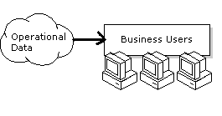
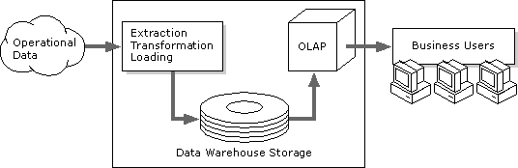
Reporting from OLTP Vs OLAP
Reports from OLTP data
Reports from OLAP data

Slide 9
OLAP Tools

Slide 10
Major OLAP Tools in market
MS SQL Server
Business Objects (SAP)
Cognos (IBM)
Hyperion/Oracle (Oracle)
Micro Strategy

Slide 11
OLAP in MS SQL Server
Initial version of OLAP technology is Incorporated in SQL Server 7.0
SQL Server 2000 is empowered with stable OLAP and referred as Microsoft SQL Server Analysis Services (MSAS)
SQL Server 2005 has the re-architected OLAP to cater the Enterprise wide needs. This is more scalable with higher performance and user-friendly UI
SQL Server 2008 has improved with few UI changes, scalability and server administration

Slide 12
Building blocks of SQL Server Analysis Services (SSAS)
Data Source & Data Source View
Dimension
Cube
Partition
Storage Modes
Programming Languages
Applicability of OLAP to Explorer Utility

Slide 13
Data Source & Data Source View
Data Source:
Data Source is a source of data
Data Source can be RDBMS or File or Web Service
Data Source View:
A data source view contains the logical model of the schema used by database objects—namely cubes, dimensions, and mining structures
can be built over one or more data sources
can contain relationships, calculated columns, and queries that are not present in the underlying data source
is not visible to client applications
DSV acts like a single Relational database schema to the DSV consumers

Slide 14
CUBE
Cube is defined by its measures and dimensions.
The measures and dimensions in a cube are derived from tables and views listed in the data source view.
Cube consists of measures based on one or more fact tables.
Cube consists of dimensions based on one or more dimension tables.
Data in RDBMS is represented in Tables (Rows, Columns) or 2 dimensional storage.
Data in Cube is represented in multi dimensional storage.

Slide 15
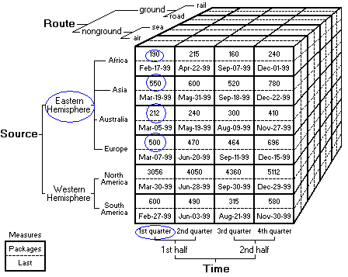
CUBE – Multi Dimensional View
Measures:
imported Packages
Last received date
Dimensions:
The Route dimension
The Source dimension
The Time dimension

Slide 16
CUBE – Two Dimensional View
Measures =>
Packages
Last
All Sources
Eastern Hemisphere
Western Hemisphere
All Sources
Eastern Hemisphere
Western Hemisphere
All Time
25110
6547
18563
Dec-29-99
Dec-22-99
Dec-29-99
1st half
11173
2977
8196
Jun-28-99
Jun-20-99
Jun-28-99
1st quarter
5108
1452
3656
Mar-30-99
Mar-19-99
Mar-30-99
2nd quarter
6065
1525
4540
Jun-28-99
Jun-20-99
Jun-28-99
2nd half
13937
3570
10367
Dec-29-99
Dec-22-99
Dec-29-99
3rd quarter
6119
1444
4675
Sep-30-99
Sep-18-99
Sep-30-99
4th quarter
7818
2126
5692
Dec-29-99
Dec-22-99
Dec-29-99

Slide 17
Online Analytical Processing (OLAP)
Employee dimension table
EmployeeID
Employee Name
Cube Storage in 2dim view
1
Emp1
Combination
Value
2
Emp2
(Emp1, Basic)
100
3
Emp3
(Emp1, Da)
10
(Emp1, Salary)
110
Payroll dimension table
(Emp2, Basic)
110
(Emp2, Da)
11
EmployeeID
Basic
Da
Sal
(Emp2, Salary)
121
1
100
10
110
(Emp3, Basic)
120
2
110
11
121
(Emp3, Da)
12
3
120
12
132
(Emp3, Salary)
132
(Basic)
330
Cube creates 12 cells to store the data.
Total 3! * 3! = 12 values (Cells)
(Da)
33
(Salary)
363

Slide 18
CUBE
Fact table:
Fact table is similar to Transaction table
Contains measure column
Contains unique rows
Generally it is in a de-normalized form
Maintains foreign key relationships lookup tables
Data is maintained in the time context

Slide 19
CUBE
Measure:
A measure generally represents a numeric column in a fact table
Measure Group:
A measure group contains group of measures from a single fact table
A cube can contain several measure groups
Aggregates:
Business users of a cube can determine its measures' values for each member of the dimension

Slide 20
Dimensions
Dimensions organize data with relation to an area of interest, such as customers, stores, or employees, to users
In common terminology dimension tables nothing but Master or Lookup or Reference tables
Dimensions contain attributes that correspond to columns in dimension tables
Dimension attributes appear as attribute hierarchies
Dimensions can be stored in MOLAP or ROLAP

Slide 21
Attributes and Attribute Hierarchies
Attribute:
In general columns need to display on a report are identified as Attributes
In general each attribute is sourced from a single column of a dimension
In general Attribute names are unique
Attribute Hierarchies:
Attributes can be organized into Hierarchies for logical representation
For example, the following table defines a dimension main table for a time dimension. The dimension main table supports three attributes, named Year, Quarter, and Month

Slide 22
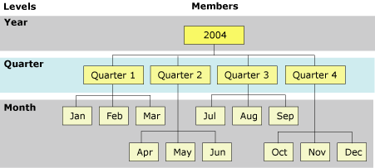
Attributes and Attribute Hierarchies
Sample Time Table
Year
Quarter
Month
2004
Quarter 1
Jan
2004
Quarter 1
Feb
2004
Quarter 1
Mar
2004
Quarter 2
Apr
2004
Quarter 2
May
2004
Quarter 2
Jun
2004
Quarter 3
Jul
2004
Quarter 3
Aug
2004
Quarter 3
Sep
2004
Quarter 4
Oct
2004
Quarter 4
Nov
2004
Quarter 4
Dec

Slide 23
Dimension Relationship Types
Regular Dimension Relationship
Reference Dimension Relationship
Fact Dimension Relationship
Many to Many Dimension Relationship

Slide 24
Dimension Relationships
Regular Dimension Relationship:
Primary Key column of a dimension is joined directly to a fact table
This relation appears in star schema design
Reference Dimension Relationship:
One dimension table refers to another dimension table and first tables’ primary key is referred in Fact table
Then second dimension is called as a Reference Dimension
This situation arises when these two dimension tables are in 3rd Normalized form/snowflake schema design

Slide 25
Dimension Relationships
Fact Dimension Relationship:
A dimension is created based on the fact table itself
Such dimension is called as Fact dimension or degenerate dimension
For example: DespatchTrackingCode or SalesTrackingNumber or SalesTransactionNumber
Many to Many Dimension Relationship:
For example, a bank customer may have multiple accounts (checking, saving, credit card, and investment accounts) while an account can also have joint or multiple owners. The Customer dimension constructed from such relationships would then have multiple members that relate to a single account transaction

Slide 26
Calculated Member & Action
Calculated Member:
A calculated member is a runtime evaluated expression using Multidimensional Expressions (MDX) script
Calculated members can be defined for any dimension, including the measures dimension
Action:
Actions are like events/trigger
Can call a program to update or retrieve from cube or database at runtime

Slide 27
Key Performance Indicator
In business terminology, a key performance indicator (KPI) is a quantifiable measurement for gauging business success. A KPI is frequently evaluated over time
For example, the sales department of an organization may use monthly gross profit as a key performance indicator, but the human resources department of the same organization may use quarterly employee turnover.
KPIs are defined as part of a cube by using the KPIs tab of Cube Designer.
KPIs are associated with a single measure group within the cube or with all measure groups in the cube
KPIs are defined using MDX expressions
KPIs are similar to Calculated Members

Slide 28
Partitions
Every measure group has at least one partition by default
A Partition is used to manage and store data
A Measure group can have several partitions
Each partition is stored in a separate set of files. These set of files can be either on local system or remote system
Partitions help in increased storage and retrieval faster
A partition is based on a table or view or named query
Typically, you can partition a measure group horizontally or vertically

Slide 29
Storage Modes
Multidimensional OLAP (MOLAP)
Relational OLAP (ROLAP)
Hybrid OLAP (HOLAP)

Slide 30
Multidimensional OLAP (MOLAP)
Stores the aggregations of the partition
Structure is highly optimized to maximize query performance
Supports Local Partition & Remote Partition
Stores a copy of its source data
Provides the most rapid query response times

Slide 31
Relational OLAP (ROLAP)
Stores the aggregations of the partition
DOES NOT Store a copy of its source data
Query response is generally slower
Processing time is typically slower
Real-time ROLAP is typically used when clients need to see changes immediately.
No aggregations are stored with real-time ROLAP.
ROLAP is also used to save storage space for large datasets that are infrequently queried, such as purely historical data.
Indexed views will be created to contain aggregations of the partition

Slide 32
Hybrid OLAP (HOLAP)
Combines features of both MOLAP and ROLAP
Stores the aggregations of the partition to be stored in a multidimensional structure
DOES NOT store a copy of the source data
Queries that access summary data refers MOLAP
Queries that access source/raw data refers from the relational database
Partitions stored as HOLAP are smaller than equivalent MOLAP partitions
HOLAP storage is suitable for queries rapid response for summaries based on a large amount of source data

Slide 33
Perspectives & Translations
Perspectives:
A Perspective is a logical grouping of cube objects for viewing purpose
Business users can refer perspective to simplify the view of a cube
A Perspective can be compared to a view in a RDBMS schema and cube with a table. Only difference is that perspectives do not support access permissions
Translations:
Translations provide support for multiple languages
For each language we can define a different source column for a dimension attribute
Dimension attributes will be displayed in local language to the users based on the system local settings

Slide 34
Cube Processing
Incremental Process:
Appends only new members to the dimension and only new records from the fact table to the measure group partition. In case there are any deleted members in the dimension table those are not applied to the dimension.
Full Process:
Rebuilds the dimension and rebuilds the partition to synchronize with the current state of the dimension and fact tables.

Slide 35
Programming Languages

Slide 36
Programming Languages
Multidimensional Expressions (MDX):
Multidimensional Expressions (MDX) is a fully-featured, statement-based scripting language used to work with multidimensional objects
MDX features can be extended with user-defined functions
Analysis Management Objects (AMO):
AMO library provides a complete set of Microsoft.NET Framework objects to manage SSAS objects
XML for Analysis (XMLA):
XML for Analysis (XMLA) is a Simple Object Access Protocol (SOAP)-based XML protocol, designed specifically for universal data access to any standard multidimensional data source residing on the Web
Analysis Management Objects (AMO) and ADOMD.NET use the XMLA protocol when communicating with an instance of Analysis Services

Slide 37
Sample Application

Slide 38
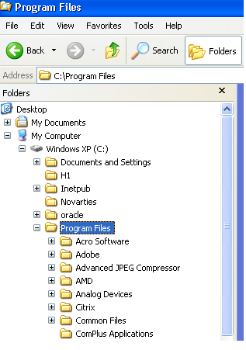
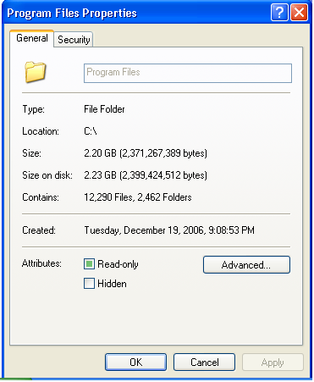
Applicability of OLAP to Explorer Utility
Open Program Files Properties window. That looks like right side image.

Slide 39
Applicability of OLAP to Explorer Utility
Dimensions:
All folders and File names from a system are part of a single dimension. Since the nature of below measures are text based and we want to view/display the characteristics of drive/folder/file we define below measures as properties of attributes.
Type: Property of an Attribute
Location: Property of an Attribute
Read-only: Property of an Attribute
Hidden: Property of an Attribute
Measures: Below measures are numeric we keep these as measures.
Size: Bytes
Size on disk: Bytes
Contains Files: Number of Files
Contains Folders: Number of Folders

Slide 40
Applicability of OLAP to Explorer Utility
Observation:
First time when you open the properties window, Size of the folder gets calculated/counted. It may take couple of seconds. Basically, first time it starts counting the size of each folder/file and accumulates.
Close the window and reopen the properties window again:
Now all the counts are displayed at a time without any delay. This is because, results are cached. OLAP cube also does similar to this. Once data is ready in the database, cube needs to be processed for aggregating the data and store it for later use. Once user accesses the measures, will get the results without any delay.

Slide 41
Thank You
Edukondalu Posina
Project Leader
edukondalu.posina@wipro.com

